Slide 1



Intents and Multiple Activity

Slide 2
Intent
Intent: allow to start another activity to perform specific tasks like:
  View a map.
  Call the alarm clock.
  Take a picture.
Implicit Intents: calling a general task without naming a specific class name or package with app name.
Explicit Intents: Naming a class name explicitly , or package name with an app name.

Slide 3
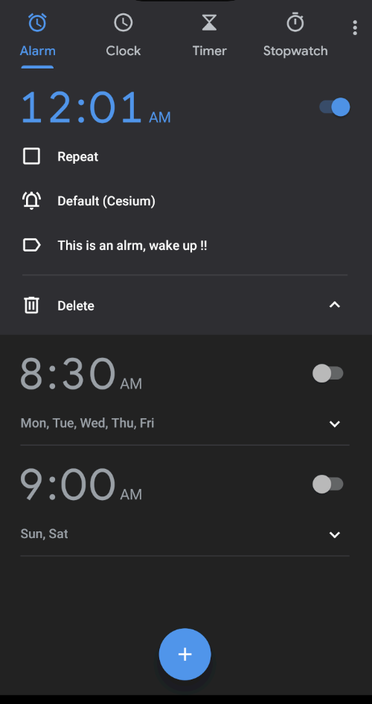
Alarm Intent Project
package com.example.alarmintent
import androidx.appcompat.app.AppCompatActivity
import android.os.Bundle
import android.content.ActivityNotFoundException
import android.content.Intent
import android.provider.AlarmClock
class MainActivity : AppCompatActivity() {
override fun onCreate(savedInstanceState: Bundle?) {
super.onCreate(savedInstanceState)
setContentView(R.layout.activity_main)
createAlarm("This is an alarm, wake up !!", 0, 1)
}//onCreate
//create fun createAlartm
}

Slide 4
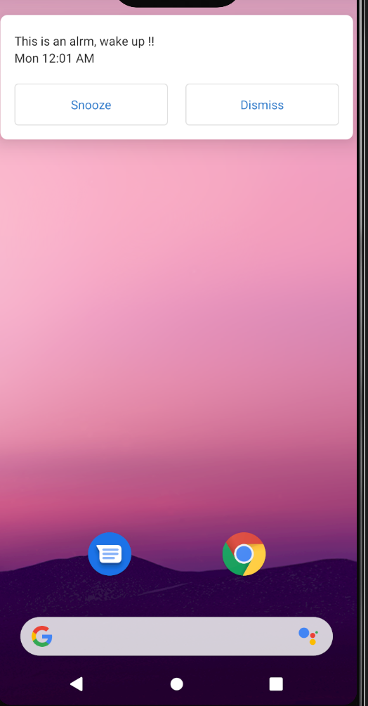
Intent and startActivity
class MainActivity : AppCompatActivity() {
………
//create fun createAlartm
fun createAlarm(message: String, hour: Int, minutes: Int) {
val intent = Intent(AlarmClock.ACTION_SET_ALARM).apply {
putExtra(AlarmClock.EXTRA_MESSAGE, message)
putExtra(AlarmClock.EXTRA_HOUR, hour)
putExtra(AlarmClock.EXTRA_MINUTES, minutes)
}
if (intent.resolveActivity(packageManager) != null) {
startActivity(intent)
}
}
}
In AndroidManifest.XML
<manifest xmlns:android="http://schemas.android.com/apk/res/android"
package="com.example.alarmintent">
<uses-permission android:name="com.android.alarm.permission.SET_ALARM" />

Slide 5
Implicit Intent: Message Intent
import androidx.appcompat.app.AppCompatActivity
import android.os.Bundle
import android.content.ActivityNotFoundException
import android.content.Intent
class MainActivity : AppCompatActivity() {
override fun onCreate(savedInstanceState: Bundle?) {
super.onCreate(savedInstanceState)
setContentView(R.layout.activity_main)
// Map point based on address
// Create the text message with a string.
val textMessage : String = "Keef halak"
val sendIntent = Intent().apply {
action = Intent.ACTION_SEND
putExtra(Intent.EXTRA_TEXT, textMessage)
type = "text/plain"
}
// Try to invoke the intent.
try {
startActivity(sendIntent)
} catch (e: ActivityNotFoundException) {
// Define what your app should do if no activity can handle the intent.
}
}
}
Implicit, any App that has an

Slide 6
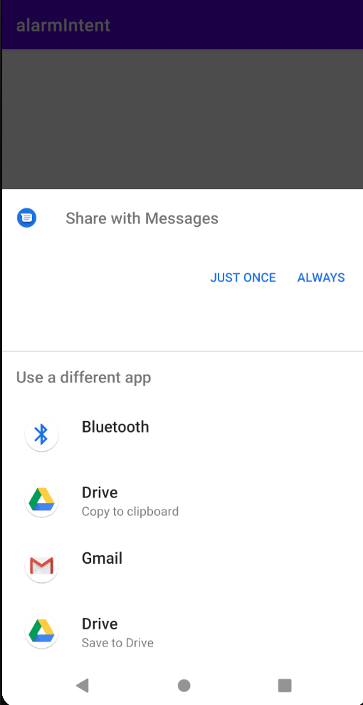
Chooser Dialog
Since we have not specify a specific app.
Therefore, android forces us to select which app to use for this intent.

Slide 7
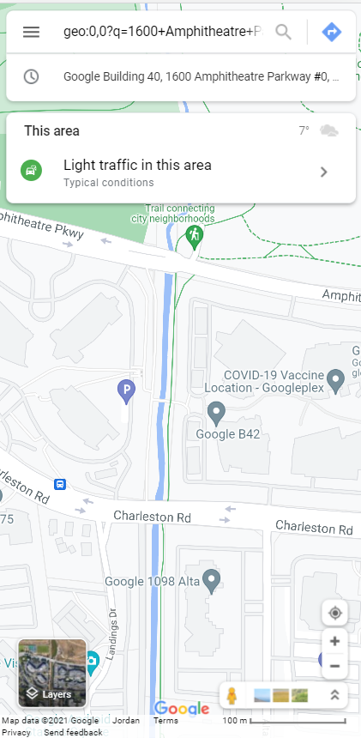
Map Intent
import androidx.appcompat.app.AppCompatActivity
import android.os.Bundle
android.content.Intent
import android.net.Uri
class MainActivity : AppCompatActivity() {
override fun onCreate(savedInstanceState: Bundle?) {
super.onCreate(savedInstanceState)
setContentView(R.layout.activity_main)
// Map point based on address
val mapIntent: Intent = Uri.parse(
"geo:0,0?q=1600+Amphitheatre+Parkway,+Mountain+View,+California"
).let { location ->
// Or map point based on latitude/longitude
// val location: Uri = Uri.parse("geo:37.422219,-122.08364?z=14") // z param is zoom level
Intent(Intent.ACTION_VIEW, location)
}
startActivity(mapIntent);
}
}

Slide 8
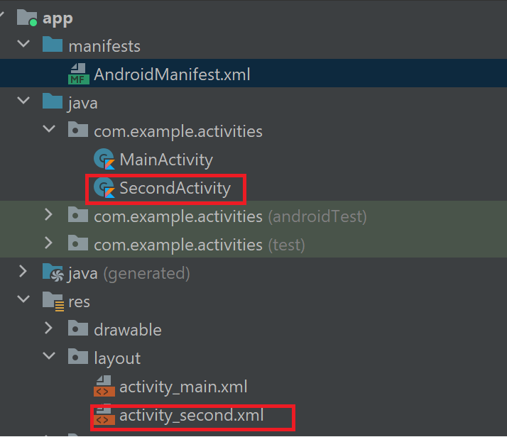
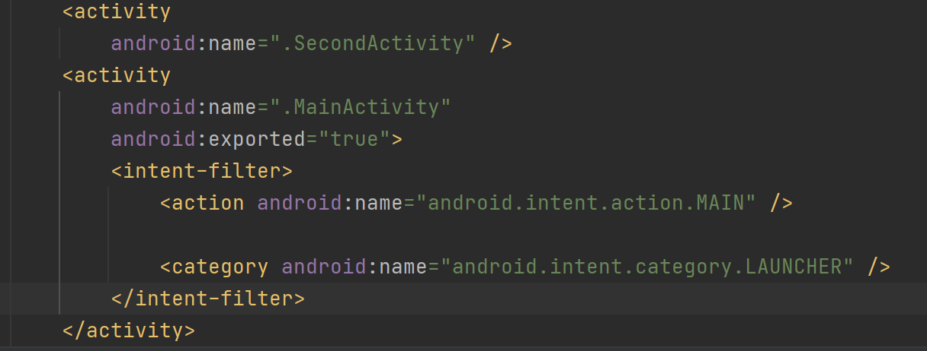
Explicit Intent
Create a new empty project, name it as activities.
In addition to MainActivity, we are going to create SecondActivity.
Create SecondActivity.kt class and activity_second.xml
Declare SecondActivity in AndroidManifest.xml

Slide 9
activity_main.xml
<?xml version="1.0" encoding="utf-8"?>
<RelativeLayout
xmlns:android="http://schemas.android.com/apk/res/android"
xmlns:app="http://schemas.android.com/apk/res-auto"
xmlns:tools="http://schemas.android.com/tools"
android:layout_width="match_parent"
android:layout_height="match_parent"
android:padding="10dp"
tools:context=".MainActivity">
<EditText
android:id="@+id/etUserMessage"
android:layout_width="match_parent"
android:layout_height="wrap_content"
android:layout_alignParentTop="true"
android:layout_centerHorizontal="true"
android:layout_marginTop="165dp"
android:ems="10"
android:hint="@string/et_enter_msg"/>
<Button
android:id="@+id/btnSendMsgToNextActivity"
android:layout_width="match_parent"
android:layout_height="wrap_content"
android:layout_centerInParent="true"
android:text="@string/btn_move_to_next_activity" />
</RelativeLayout>

Slide 10
MainActivity.kt
// IMPORTS
package com.example.activities
import android.content.Intent
import android.os.Bundle
import androidx.appcompat.app.AppCompatActivity
import android.widget.Button
import android.widget.EditText

Slide 11
MainActivity.kt
class MainActivity : AppCompatActivity() {
override fun onCreate(savedInstanceState: Bundle?) {
super.onCreate(savedInstanceState)
setContentView(R.layout.activity_main)
val etUserMessage: EditText = findViewById(R.id.etUserMessage)
val btnSendMsgToNextActivity: Button = findViewById(R.id.btnSendMsgToNextActivity)
btnSendMsgToNextActivity.setOnClickListener {
val message: String = etUserMessage.text.toString()
val intent = Intent(this, SecondActivity::class.java)
intent.putExtra("key", message)
startActivity(intent)
}
}
}
NOTICE: Explicit call for the specific class
Sending an Extra

Slide 12
activity_second.xml
<?xml version="1.0" encoding="utf-8"?>
<LinearLayout
xmlns:android="http://schemas.android.com/apk/res/android"
android:layout_width="match_parent"
android:layout_height="match_parent"
android:orientation="horizontal">
<TextView
android:id="@+id/txvUserMessage"
android:layout_width="match_parent"
android:layout_height="wrap_content"
android:layout_margin="20dp"
android:text="TextView"
android:textAlignment="center"
android:textColor="#f40d30"
android:textSize="30sp"
android:textStyle="bold"/>
</LinearLayout>

Slide 13
SecondActivity.kt
package com.example.activities
import android.os.Bundle
import android.widget.Toast
import androidx.appcompat.app.AppCompatActivity
class SecondActivity : AppCompatActivity() {
override fun onCreate(savedInstanceState: Bundle?) {
super.onCreate(savedInstanceState)
setContentView(R.layout.activity_second)
// Safe Call ?.
// Safe Call with let ?.let { }
val bundle: Bundle? = intent.extras
bundle?.let {
val msg = bundle.getString("key")
Toast.makeText(this,msg,Toast.LENGTH_SHORT).show()
}
}
}
Receiving the extra

Slide 14
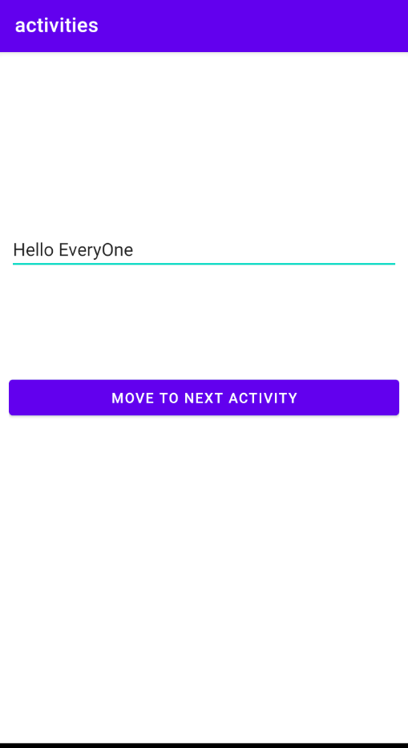
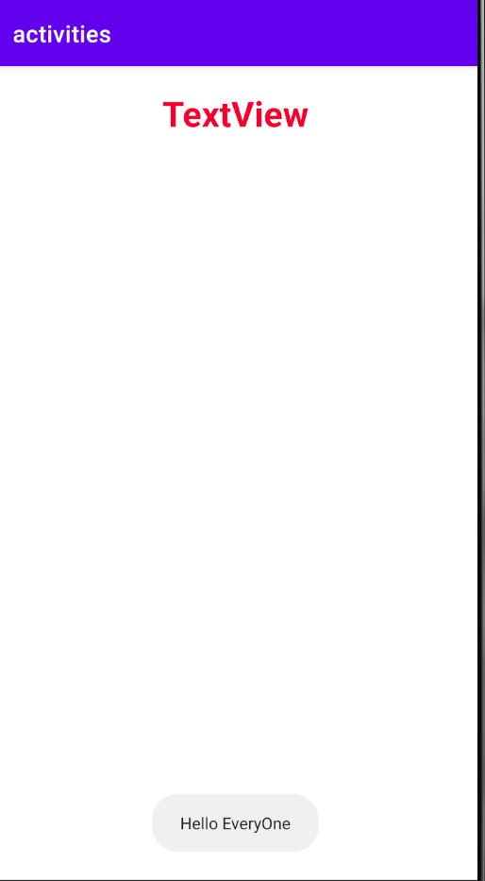
Run

Slide 15
References
https://developer.android.com/guide/components/intents-filters
https://developer.android.com/training/basics/intents/sending#Build
https://www.youtube.com/watch?v=rLTrM7Lgq4s

